Slide 1
Lecture 4.2 ECMA Script
Nisar Ahmed Siddiqui

Slide 2
ECMA Script
JavaScript was invented by Brendan Eich in 1995, and became an ECMA standard in 1997.
ECMAScript is the official name of the language.
ECMAScript versions have been abbreviated to ES1, ES2, ES3, ES5, and ES6.
Since 2016, versions are named by year (ECMAScript 2016, 2017, 2018, 2019, 2020).

Slide 3
New features in ES6
The let keyword
The const keyword
Arrow Functions
The ... Operator
For/of
Map Objects
Set Objects
Classes
Promises
Function Rest Parameter
New Math Methods
New Number Properties
New Number Methods
New Global Methods
Object entries
JavaScript Modules

Slide 4
ECMAScript 2016
New Features in ECMAScript 2016
JavaScript Exponentiation (**)
JavaScript Exponentiation assignment (**=)
JavaScript Array includes()
Notes:
Here’s a breakdown of the new features introduced in ECMAScript 2017 (ES8), ECMAScript 2018 (ES9), and ECMAScript 2019 (ES10):
### **New Features in ECMAScript 2017 (ES8)**
1. **JavaScript String Padding (`padStart` and `padEnd`)**
String padding methods were introduced to add padding to the beginning (`padStart()`) or the end (`padEnd()`) of a string to meet a desired length.
**Syntax:**
```javascript
str.padStart(targetLength, padString);
str.padEnd(targetLength, padString);
```
**Example:**
```javascript
'5'.padStart(3, '0'); // '005'
'5'.padEnd(3, '0'); // '500'
```
2. **JavaScript Object `entries()`**
The `Object.entries()` method returns an array of a given object's own enumerable string-keyed property `[key, value]` pairs.
**Syntax:**
```javascript
Object.entries(obj);
```
**Example:**
```javascript
const obj = { a: 1, b: 2 };
console.log(Object.entries(obj)); // [['a', 1], ['b', 2]]
```
3. **JavaScript Object `values()`**
The `Object.values()` method returns an array of a given object's own enumerable property values.
**Syntax:**
```javascript
Object.values(obj);
```
**Example:**
```javascript
const obj = { a: 1, b: 2 };
console.log(Object.values(obj)); // [1, 2]
```
4. **JavaScript `async` and `await`**
These are used for handling asynchronous code more easily, allowing you to write asynchronous code that looks like synchronous code.
**Syntax:**
```javascript
async function myFunction() {
let result = await someAsyncOperation();
console.log(result);
}
```
**Example:**
```javascript
async function fetchData() {
let response = await fetch('https://api.example.com');
let data = await response.json();
console.log(data);
}
```
5. **JavaScript `Object.getOwnPropertyDescriptors()`**
This method returns all own property descriptors of an object, including those for non-enumerable properties.
**Syntax:**
```javascript
Object.getOwnPropertyDescriptors(obj);
```
**Example:**
```javascript
const obj = { a: 1 };
console.log(Object.getOwnPropertyDescriptors(obj));
```
---
### **New Features in ECMAScript 2018 (ES9)**
1. **Asynchronous Iteration**
This allows asynchronous iteration over objects with the `for-await-of` loop, enabling you to work with asynchronous data sources like streams.
**Syntax:**
```javascript
for await (const item of asyncIterable) {
// process item
}
```
**Example:**
```javascript
async function fetchData() {
const data = [Promise.resolve(1), Promise.resolve(2)];
for await (let item of data) {
console.log(item); // 1, then 2
}
}
fetchData();
```
2. **Promise `finally()`**
The `finally()` method allows you to specify a callback to run after a promise has been settled (fulfilled or rejected), which is useful for cleaning up.
**Syntax:**
```javascript
promise.finally(callback);
```
**Example:**
```javascript
fetch('data.json')
.then(response => response.json())
.finally(() => console.log('Request completed'));
```
3. **Object Rest Properties**
Object rest properties allow you to collect the remaining properties of an object into a new object.
**Syntax:**
```javascript
const { prop1, prop2, ...rest } = obj;
```
**Example:**
```javascript
const obj = { a: 1, b: 2, c: 3 };
const { a, ...rest } = obj;
console.log(rest); // { b: 2, c: 3 }
```
4. **New RegExp Features**
ES9 introduced several improvements to regular expressions:
- **Named capture groups**: Allow named groups in regex.
- **Lookbehind assertions**: Allow lookbehind in regex.
- **Unicode property escapes**: Let you match characters based on Unicode properties.
**Example:**
```javascript
const regex = /(?<=@)\w+/;
const email = 'user@example.com';
const match = email.match(regex);
console.log(match); // 'example'
```
5. **JavaScript Shared Memory**
Shared memory and atomic operations were introduced to help with parallel programming. The `SharedArrayBuffer` object allows sharing memory between threads.
---
### **New Features in ECMAScript 2019 (ES10)**
1. **String `trimStart()` and `trimEnd()`**
These methods are used to trim whitespace from the beginning (`trimStart()`) and the end (`trimEnd()`) of a string.
**Syntax:**
```javascript
str.trimStart();
str.trimEnd();
```
**Example:**
```javascript
const str = ' hello ';
console.log(str.trimStart()); // 'hello '
console.log(str.trimEnd()); // ' hello'
```
2. **Object `fromEntries()`**
This method transforms a list of key-value pairs into an object.
**Syntax:**
```javascript
Object.fromEntries(iterable);
```
**Example:**
```javascript
const entries = [['a', 1], ['b', 2]];
console.log(Object.fromEntries(entries)); // { a: 1, b: 2 }
```
3. **Optional `catch` Binding**
ES10 allows omitting the error parameter in a `catch` block if it's not needed.
**Syntax:**
```javascript
try {
// code
} catch {
// no error object needed
}
```
**Example:**
```javascript
try {
throw new Error('An error occurred');
} catch {
console.log('Caught an error');
}
```
4. **Array `flat()`**
This method flattens an array, allowing you to reduce nested arrays into a single array.
**Syntax:**
```javascript
array.flat(depth);
```
**Example:**
```javascript
const arr = [1, [2, 3], [4, 5]];
console.log(arr.flat()); // [1, 2, 3, 4, 5]
```
5. **Array `flatMap()`**
This method first maps each element using a mapping function, then flattens the result into a new array.
**Syntax:**
```javascript
array.flatMap(callback);
```
**Example:**
```javascript
const arr = [1, 2, 3];
console.log(arr.flatMap(x => [x, x * 2])); // [1, 2, 2, 4, 3, 6]
```
6. **Revised `Array.sort()`**
The `Array.sort()` method was revised to ensure consistent results across different JavaScript engines when sorting numbers.
7. **Revised `JSON.stringify()`**
The `JSON.stringify()` method now includes a `replacer` function that allows for more control over the stringification of objects.
8. **Separator Symbols Allowed in String Literals**
This allows the use of separators in template strings, making them easier to format.
9. **Revised `Function.toString()`**
The `Function.toString()` method now consistently returns the source code of functions, even for arrow functions.

Slide 5
ECMAScript 2017
New Features in ECMAScript 2017
JavaScript String padding
JavaScript Object entries()
JavaScript Object values()
JavaScript async and await
JavaScript Object.getOwnPropertyDescriptors
Notes:
Here’s an overview of the new features introduced in **ES2020** and **ES2021**:
---
### **New Features in ES2020 (ECMAScript 2020)**
1. **BigInt**
The `BigInt` type was introduced to handle arbitrarily large integers beyond the limits of the `Number` type (which can safely represent integers up to \(2^{53} - 1\)).
**Syntax:**
```javascript
const bigInt = 1234567890123456789012345678901234567890n;
```
**Example:**
```javascript
const bigNum = BigInt(123456789012345678901234567890);
console.log(bigNum + 1n); // BigInt value, result is a BigInt
```
2. **String `matchAll()`**
The `matchAll()` method returns an iterator of all results matching a regular expression, including capturing groups, for a given string.
**Syntax:**
```javascript
str.matchAll(regex);
```
**Example:**
```javascript
const str = "test1 test2 test3";
const regex = /\w+/g;
const matches = str.matchAll(regex);
for (const match of matches) {
console.log(match);
}
// Output: ['test1'], ['test2'], ['test3']
```
3. **The Nullish Coalescing Operator (`??`)**
The `??` operator is a logical operator that returns the right-hand side operand when the left-hand side operand is `null` or `undefined`.
**Syntax:**
```javascript
let result = a ?? b;
```
**Example:**
```javascript
let a = null;
let b = "Hello";
console.log(a ?? b); // "Hello"
```
4. **The Optional Chaining Operator (`?.`)**
The `?.` operator allows you to safely access deeply nested properties of an object without throwing an error if an intermediate property is `null` or `undefined`.
**Syntax:**
```javascript
obj?.property
obj?.method?.()
```
**Example:**
```javascript
const obj = { user: { name: "Alice" } };
console.log(obj?.user?.name); // "Alice"
console.log(obj?.user?.age); // undefined
```
5. **Logical AND Assignment (`&&=`)**
This is a shorthand operator that updates the value of a variable only if the left-hand side is truthy.
**Syntax:**
```javascript
a &&= b;
```
**Example:**
```javascript
let a = true;
let b = false;
a &&= b; // a is now false
console.log(a); // false
```
6. **Logical OR Assignment (`||=`)**
This operator updates the value of a variable only if the left-hand side is falsy.
**Syntax:**
```javascript
a ||= b;
```
**Example:**
```javascript
let a = null;
let b = "Hello";
a ||= b; // a is now "Hello"
console.log(a); // "Hello"
```
7. **Nullish Coalescing Assignment (`??=`)**
The `??=` operator updates the value of a variable only if the left-hand side is `null` or `undefined`.
**Syntax:**
```javascript
a ??= b;
```
**Example:**
```javascript
let a = null;
let b = "Hello";
a ??= b; // a is now "Hello"
console.log(a); // "Hello"
```
8. **Dynamic `import`**
`import()` is a function that allows you to dynamically load modules at runtime, providing better control over the loading of dependencies.
**Syntax:**
```javascript
import('module').then((module) => {
// use the module
});
```
**Example:**
```javascript
if (someCondition) {
import('./module.js').then((module) => {
module.someFunction();
});
}
```
---
### **New Features in ES2021 (ECMAScript 2021)**
1. **`Promise.any()`**
The `Promise.any()` method takes an array of promises and resolves as soon as any one of the promises is fulfilled. If all promises are rejected, it returns an `AggregateError`.
**Syntax:**
```javascript
Promise.any([promise1, promise2, promise3])
.then(result => console.log(result))
.catch(error => console.log(error));
```
**Example:**
```javascript
const prom1 = Promise.reject('Failed');
const prom2 = Promise.resolve('Success');
const prom3 = Promise.resolve('Another success');
const first = await Promise.any([prom1, prom2, prom3]);
console.log(first); // 'Success'
```
2. **String `replaceAll()`**
The `replaceAll()` method allows you to replace all occurrences of a substring or a pattern in a string, unlike `replace()`, which only replaces the first occurrence.
**Syntax:**
```javascript
str.replaceAll(searchValue, replaceValue);
```
**Example:**
```javascript
const str = "apple, banana, apple";
console.log(str.replaceAll('apple', 'orange')); // "orange, banana, orange"
```
3. **Numeric Separators (`_`)**
Numeric separators allow you to insert underscores (`_`) into numbers for better readability, especially in large numbers.
**Syntax:**
```javascript
const largeNumber = 1_000_000;
const binary = 0b1010_1101_0101;
const hex = 0xFF_FF_FF;
```
**Example:**
```javascript
const number = 1_000_000;
console.log(number); // 1000000
```
---
These features continue to improve JavaScript's usability, performance, and ease of use for developers working on modern web applications.

Slide 6
ECMAScript 2018
New Features in ECMAScript 2018
Asynchronous Iteration
Promise Finally
Object Rest Properties
New RegExp Features
JavaScript Shared Memory

Slide 7
ECMAScript 2019
New Features in ES2019
String.trimStart()
String.trimEnd()
Object.fromEntries
Optional catch binding
Array.flat()
Array.flatMap()
Revised Array.Sort()
Revised JSON.stringify()
Separator symbols allowed in string litterals
Revised Function.toString()

Slide 8
ECMAScript 2020
New Features in ES2020
BigInt
String matchAll()
The Nullish Coalescing Operator (??)
The Optional Chaining Operator (?.)
Logical AND Assignment Operator (&&=)
Logical OR Assignment (||=)
Nullish Coalescing Assignment (??=)
Dynamic Import

Slide 9
ECMAScript 2021
New Features in ES2021
Promise any(): const first = await Promise.any([prom1,prom2,prom3]);
String replaceAll()
Numeric Separators (_)

Slide 10
ES 6 - Features

Slide 11

JavaScript Template Literals
Back-Tics Syntax
Template Literals use back-ticks (``) rather than the quotes ("") to define a string:
With template literals, you can use both single and double quotes inside a string:

Slide 12

Interpolation
Template literals provide an easy way to interpolate variables and expressions into strings.
The method is called string interpolation.
The syntax is:
Template literals allow variables in strings:

Slide 13
Arrow functions
Already explained in previous lectures

Slide 14
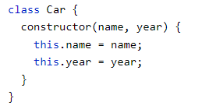


Classes
ECMAScript 2015, also known as ES6, introduced JavaScript Classes.
JavaScript Classes are templates for JavaScript Objects.
JavaScript Class Syntax
Use the keyword class to create a class.
Always add a method named constructor():

Slide 15

Using a Class
When you have a class, you can use the class to create objects:

Slide 16

Modules
JavaScript modules allow you to break up your code into separate files.
This makes it easier to maintain a code-base.
Modules are imported from external files with the import statement.
Modules also rely on type="module" in the <script> tag.

Slide 17


Export
Modules with functions or variables can be stored in any external file.
There are two types of exports: Named Exports and Default Exports.
Named Exports
Let us create a file named person.js, and fill it with the things we want to export.
You can create named exports two ways. In-line individually, or all at once at the bottom.

Slide 18
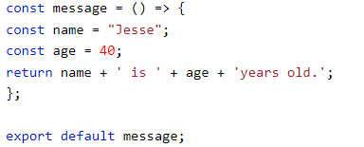
Export (cont…)
2. Default Exports
Let us create another file, named message.js, and use it for demonstrating default export.
You can only have one default export in a file.

Slide 19

Import
You can import modules into a file in two ways, based on if they are named exports or default exports.
Named exports are constructed using curly braces. Default exports are not.
Import named exports from the file person.js:
Import a default export from the file message.js:

Slide 20
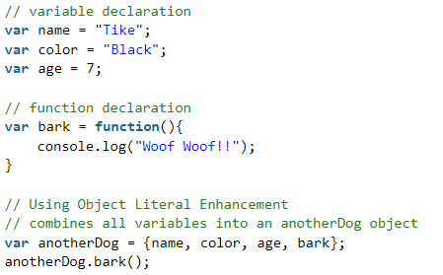
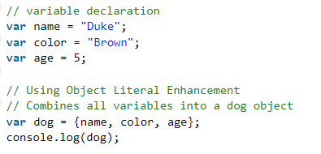
Object Literal Enhancement
Object literal enhancement is used to group variables from the global scope and form them into javascript objects. It is the process of restructuring or putting back together.

Slide 21
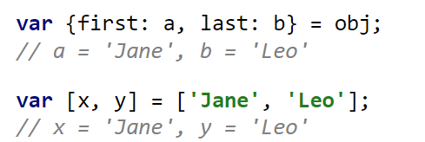
Destructuring
Destructuring is a convenient way to extract values from data stored in Objects and Arrays (also nested). This is an opposite operation to structuring (constructing data).
There is a nice syntax for constructing data in JavaScript – an object literal:
Destructuring in ECMAScript 6 enables the same syntax for extracting data.

Slide 22
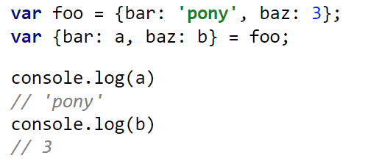
Destructuring (Object Destructuring)

Slide 23
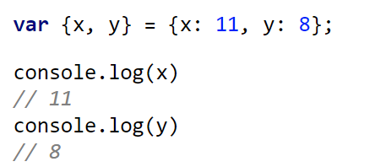
Object destructuring, shorthand notation.
Only for object literals: If the value of a property is provided via a variable whose name is the same as the property name, you can omit the property name.

Slide 24
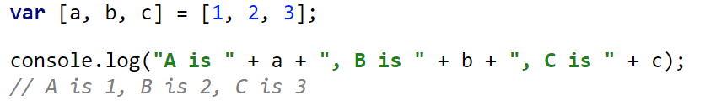

Array Destructuring
Destructuring works for arrays as well. How? By using square brackets in the destructuring side of the declaration.
OR
Notes:
Recommended read, (Rest Parameters vs Spread Operator)

Slide 25
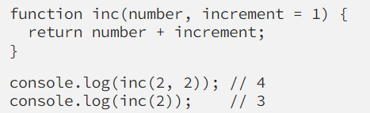
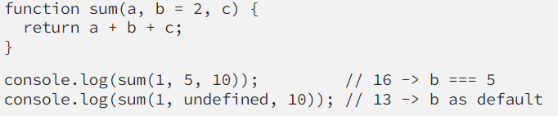
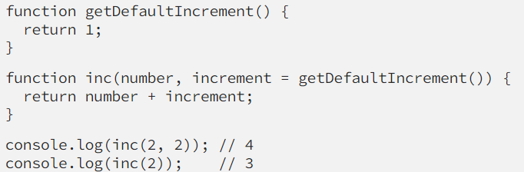
Default + Rest + Spread
We can pass the default value to a parameter.

Slide 26
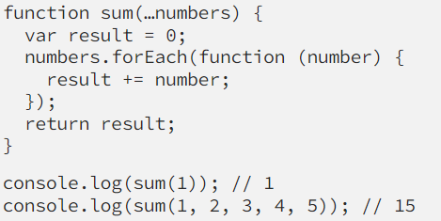
Default + Rest + Spread
The rest operator is used to condense a group of elements down into a single array.
Let’s create a function that adds three numbers together using the reduce array helper function.

Slide 27
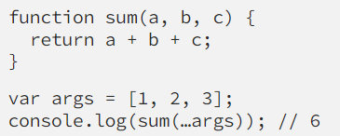
Default + Rest + Spread
The spread is closely related to rest parameters, because of … (three dots) notation. It allows to split an array to single arguments which are passed to the function as separate arguments.

Slide 28
Iterators & For…Of
Already explained in detail in last classes

Slide 29
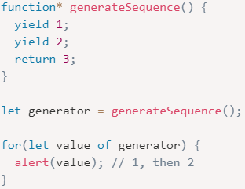
Generators
Regular functions return only one, single value (or nothing).
Generators can return (“yield”) multiple values, one after another, on-demand. They work great with iterables, allowing to create data streams with ease.
To create a generator, we need a special syntax construct: function*, so-called “generator function”.

Slide 30
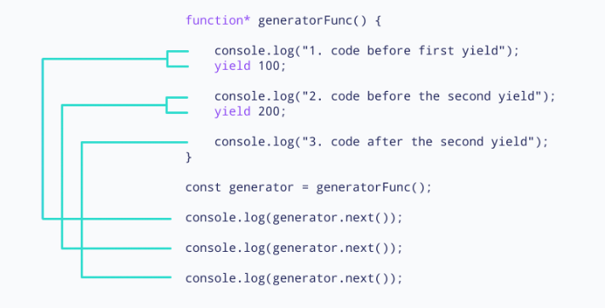
Working of generators
Using a generator,
We can stop the execution of a function from anywhere inside the function and continue executing code from a halted position

Slide 31
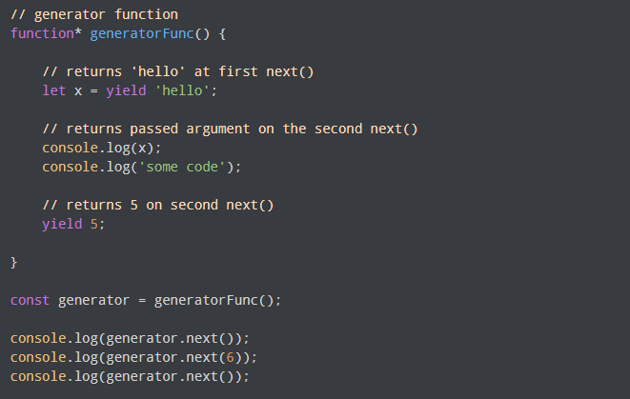
Passing Arguments to Generator Functions

Slide 32
Promises
"I Promise a Result!"
"Producing code" is code that can take some time
"Consuming code" is code that must wait for the result
A Promise is a JavaScript object that links producing code and consuming code

Slide 33
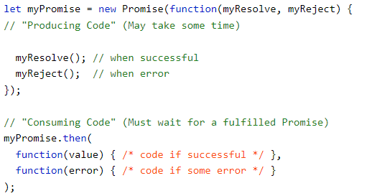
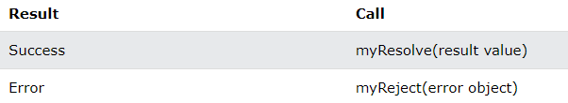
JavaScript Promise Object
A JavaScript Promise object contains both the producing code and calls to the consuming code:
When the producing code obtains the result, it should call one of the two callbacks:

Slide 34

Promise Object Properties
A JavaScript Promise object can be:
Pending
Fulfilled
Rejected

Slide 35
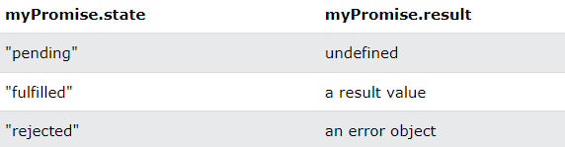
Promise Object Properties (cont…)
The Promise object supports two properties: state and result.
While a Promise object is "pending" (working), the result is undefined.
When a Promise object is "fulfilled", the result is a value.
When a Promise object is "rejected", the result is an error object.

Slide 36

Promise How To
Promise.then() takes two arguments, a callback for success and another for failure.
Both are optional, so you can add a callback for success or failure only.

Slide 37
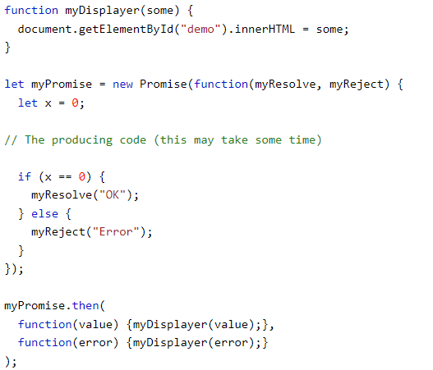
Example

Slide 38

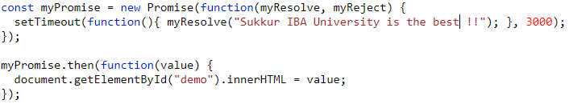
JavaScript Promise Examples (settimeout)
To demonstrate the use of promises, we will use the callback
Waiting for a Timeout
Notes:
Yes, you can use only `.then` with a Promise even if you’ve passed both `resolve` and `reject` in the promise definition. The `.then` method actually accepts two callback functions as arguments:
- The first callback handles the resolved (fulfilled) state.
- The second callback handles the rejected (error) state.
### Example of Using Only `.then` for Both Success and Error Handling
```javascript
const myPromise = new Promise((resolve, reject) => {
const success = true; // Change to false to test rejection
if (success) {
resolve("Promise resolved successfully!");
} else {
reject("Promise rejected with an error.");
}
});
myPromise.then(
(message) => {
console.log("Success:", message); // This handles the resolved case
},
(error) => {
console.error("Error:", error); // This handles the rejected case
}
);
```
### How It Works
In this example:
- The first callback `(message) => { ... }` handles the resolved state.
- The second callback `(error) => { ... }` handles the rejected state.
This way, you don’t need to chain a separate `.catch` if you’re handling both outcomes directly in `.then`.
### Differences from Using `.catch`
- Using `.then` with two callbacks can be less clear than `.then(...).catch(...)` because it doesn’t explicitly show error handling.
- `.catch` is often preferred for readability and separating the success and error paths.
### Use Case
Using both callbacks in `.then` might be preferred when:
- You want concise handling for both states in a single place.
- You have a very short and simple operation for handling errors.
However, for readability and separation of concerns, it’s often better to use `.then(...).catch(...)`.

Slide 39
JavaScript Async
"async and await make promises easier to write“
async makes a function return a Promise
await makes a function wait for a Promise
Notes:
Yes, Promises in JavaScript can be handled in two main ways: **`.then`/`.catch`** and **`async`/`await`**. Both methods provide ways to handle asynchronous code, but they differ in readability, structure, and use cases.
### 1. Handling Promises with `.then`/`.catch`
#### How it Works
- The `.then` method is used to handle a successful promise resolution.
- The `.catch` method handles promise rejections (errors).
- This style is suited for chaining multiple asynchronous operations.
#### Example
```javascript
const myPromise = new Promise((resolve, reject) => {
setTimeout(() => {
resolve("Promise resolved successfully!");
// reject("Promise rejected.");
}, 1000);
});
myPromise
.then((message) => {
console.log(message); // Executes if promise is resolved
return "Chaining another .then"; // Can chain more actions
})
.then((nextMessage) => {
console.log(nextMessage);
})
.catch((error) => {
console.error(error); // Executes if promise is rejected
});
```
#### Use Case
- `.then`/`.catch` is commonly used in scenarios where you want to **chain multiple asynchronous operations** in sequence, such as loading data in steps.
- Suitable for **legacy code** or environments that do not support `async`/`await` (e.g., older browsers).
### 2. Handling Promises with `async`/`await`
#### How it Works
- `async` functions automatically return a promise.
- `await` pauses the execution of the `async` function until the promise settles (either resolves or rejects).
- This syntax makes asynchronous code look and behave more like synchronous code, improving readability.
#### Example
```javascript
const myPromise = () => {
return new Promise((resolve, reject) => {
setTimeout(() => {
resolve("Promise resolved successfully!");
// reject("Promise rejected.");
}, 1000);
});
};
async function handlePromise() {
try {
const message = await myPromise(); // Waits until promise is resolved
console.log(message);
const nextMessage = "Processing more data after await";
console.log(nextMessage);
} catch (error) {
console.error(error); // Handles any rejection
}
}
handlePromise();
```
#### Use Case
- `async`/`await` is ideal for handling **sequential asynchronous operations** that depend on each other.
- It’s used when you need **clear, readable code** that handles asynchronous tasks in a "synchronous-like" fashion, reducing nested `.then` chains and enhancing readability.
---
### Comparison: `.then`/`.catch` vs. `async`/`await`
| Aspect | `.then`/`.catch` | `async`/`await` |
|-----------------------|--------------------------------------------|-------------------------------------------|
| **Syntax** | Functional, promise chaining | Structured, synchronous-like |
| **Error Handling** | `.catch` for rejections | `try`/`catch` for rejections |
| **Readability** | Can be harder to read in nested chains | More readable, especially with async flow |
| **Best for** | Complex promise chains, backward compatibility | Sequential async code, code clarity |
| **Error Propagation** | Errors propagate through chained promises | Use `try`/`catch` at each function level |
---
### Choosing Between `.then`/`.catch` and `async`/`await`
1. **Use `.then`/`.catch`**:
- When handling multiple asynchronous tasks independently.
- In older codebases where consistency with `.then` chains is preferred.
- For simple, quick tasks that don’t require awaiting other values.
2. **Use `async`/`await`**:
- When your async operations are dependent on one another.
- For readability and maintenance, especially with nested async tasks.
- When writing new, modern JavaScript code, as it is often clearer and easier to understand.

Slide 40


Async Syntax
The keyword async before a function makes the function return a promise:

Slide 41

Await Syntax
The await keyword can only be used inside an async function.
The await keyword makes the function pause the execution and wait for a resolved promise before it continues:

Slide 42
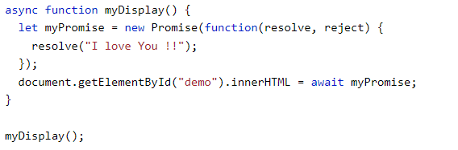
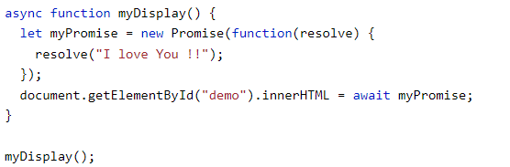
How to use async & await with promises
Without reject function

Slide 43
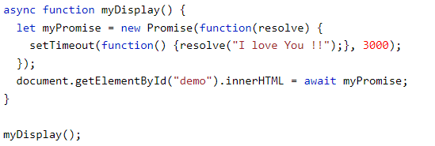
Async and await with timeouts

